Slide 1

Infrastructure in a Flash: Deploy via Code in Under 30 minutes using AWS CloudFormation
Jagrut Sharma, Sr. Computer Scientist Adobe
CloudX Conference November 2024

Slide 2

Learning goals
Understand fundamentals of AWS CloudFormation offering
Go through basic terminology
Walk through a practical template
Live demo
Take away ideas for further extensions
Get motivated to further explore the offering and apply it to your own use cases.
Have some fun!

Slide 3

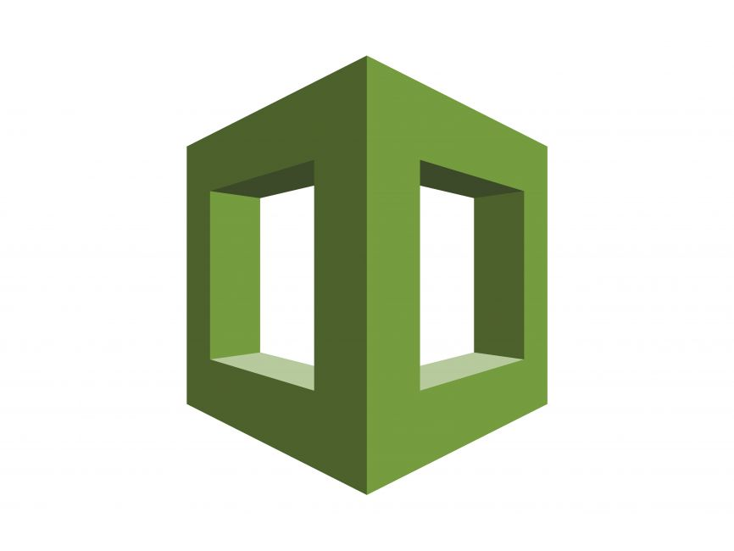
What is AWS CloudFormation?
AWS CloudFormation is a service by Amazon Web Services (AWS) designed to help users define and provision AWS infrastructure using code.
With CloudFormation, you can model, deploy, and manage AWS resources like EC2 instances, RDS databases, S3 buckets, and more in a repeatable and automated manner.
This infrastructure-as-code (IaC) approach is ideal for managing complex infrastructures across multiple environments and achieving consistent setups.

Slide 4
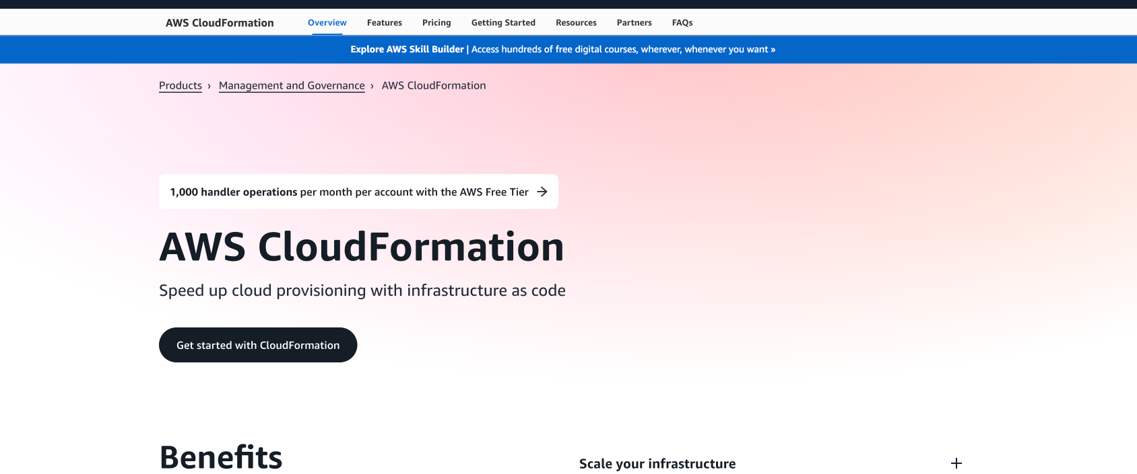
AWS UI - CloudFormation Service
https://aws.amazon.com/cloudformation/

Slide 5




Benefits of using AWS CloudFormation
Area | Benefit
Consistency and Automation | CloudFormation templates ensure consistent deployment, reducing the risk of human error.
Version Control | Since templates are just code files, they can be stored in version control systems, enabling collaboration, rollback, and versioning.
Efficient Resource Management | With resources treated as a single entity (stack), updating or deleting infrastructure is streamlined. Reduce costs by on-demand provisioning and tear down.
Scalability | CloudFormation scales with your infrastructure requirements, making it ideal for complex architectures and multi-region setups.

Slide 6

Common Use Cases
Area | Use Case
Infrastructure as Code (IaC) | Codifying infrastructure to manage it like any other code asset.
Multi-environment Management | Using different parameters or conditions for deploying consistent infrastructure across dev, test, and production environments.
Compliance and Security | Establish security baselines by defining resource configurations in code and using IAM roles, security groups, network ACLs, encryption settings.

Slide 7

Core Components – 1 of 2
Component | Description
Template | Heart of CloudFormation offering JSON or YAML file Describes resources and configurations needed Blueprint for infrastructure
Stack | Live instantiation of a template Collection of resources defined by a template Can be created, updated, or deleted as a single unit Allows efficient management of group of resources
Stack Set | Allows deploying and managing stacks across multiple AWS accounts and regions simultaneously Provides centralized control for large-scale deployments
Resources | The actual AWS resources (like EC2, RDS, VPCs) that are specified in a template A resource has configuration (required and optional properties) and dependencies Resources can expose outputs (defined in the Outputs section of a template) or allow other resources to reference their attributes.

Slide 8
Core Components – 2 of 2
Component | Description
Parameters | Allows customization and dynamically configuring stack by providing input values at deployment time. Allow making templates flexible and reusable by accepting user-defined inputs.
Conditions | Allow controlling resource creation based on environment-specific criteria Useful to spin up region-specific resources
Outputs | Defined values to make available after a stack is created Useful for sharing data between multiple stacks Allow accessing critical information about deployed resources
Mappings | Static key-value pairs that allow defining conditional values that do not change Examples are region-specific or environmental-specific configurations Example: A mapping may contain information on what region is running which instance type and AMI.

Slide 9

AWS SAM
AWS Serverless Application Model (AWS SAM) is an open-source framework for building serverless applications using infrastructure as code (IaC).
With AWS SAM’s shorthand syntax, developers declare AWS CloudFormation resources and specialized serverless resources that are transformed to infrastructure during deployment.
This framework includes two main components: the AWS SAM CLI and the AWS SAM project.
CLI commands: sam deploy, sam delete
Save deployment parameters in .toml file
Write serverless application resources as code in template.yaml file

Slide 10
Hands-on Demo

Slide 11

Requirements
User click events are generated on a real-time basis on the company website.
An API should be available to accept these events.
The user_id field should be replaced with a hash (anonymize user_id).
The user_id to hash mapping should be stored.
The updated event should be stored in an object store.
The storage location should be partitioned by Y-D-M-H.

Slide 12

Solution
Step 1: Architect the solution design
Step 2: Pick the right AWS services for the implementation
Step 3: Chart out the right configurations and permissions for the services
Step 4: (optional) Use the AWS console to implement the design
Step 5: Use CloudFormation template to deploy the solution via code
Step 6: Version control and iteratively refine the template
Step 7: Revisit the solution design – simplify, optimize, scale, secure

Slide 13











Architecture
Role
Logs
Role
Logs
1
2
3
4
5
9
click event
API Gateway
/click endpoint
Lambda
Event Processor
Kinesis
Data Streams
UserSignalsStream
S3
user signals destination bucket
Data Firehose
UserSignalsFirehose
8
6
Role
7
Logs
Lambda
Transformation
DynamoDB
14 Resources
User Anonymization Table

Slide 14

Live Demo
Git Repo:
https://github.com/jagrutsharma/cloudx-2024-iac-workshop
Walkthrough of template that implements the solution
Provisioning and deployment of resources
Teardown of resources

Slide 15

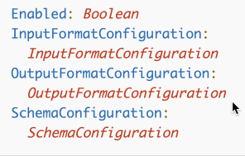

Possible Extension 1 - Easy
Requirement: Convert format of data landing in S3 from JSON to Parquet
Hint: Update Kinesis Firehose Delivery Stream
JSON
DataFormatConversionConfiguration

Slide 16



Possible Extension 2 – Medium
Requirement: Analyze S3 records via a SQL Interface
Hint 1: Create a Glue Database
AWS::Glue::Database
Hint 2: Create a Glue Data Catalog Table
AWS::Glue::Table
Hint 3: Create a Glue Crawler
AWS::Glue::Crawler
Hint 4: Run SQL Query via Athena
SELECT *
FROM "user_signals_db"."user_signals_table"
LIMIT 10;
AWS Glue
Amazon Athena

Slide 17


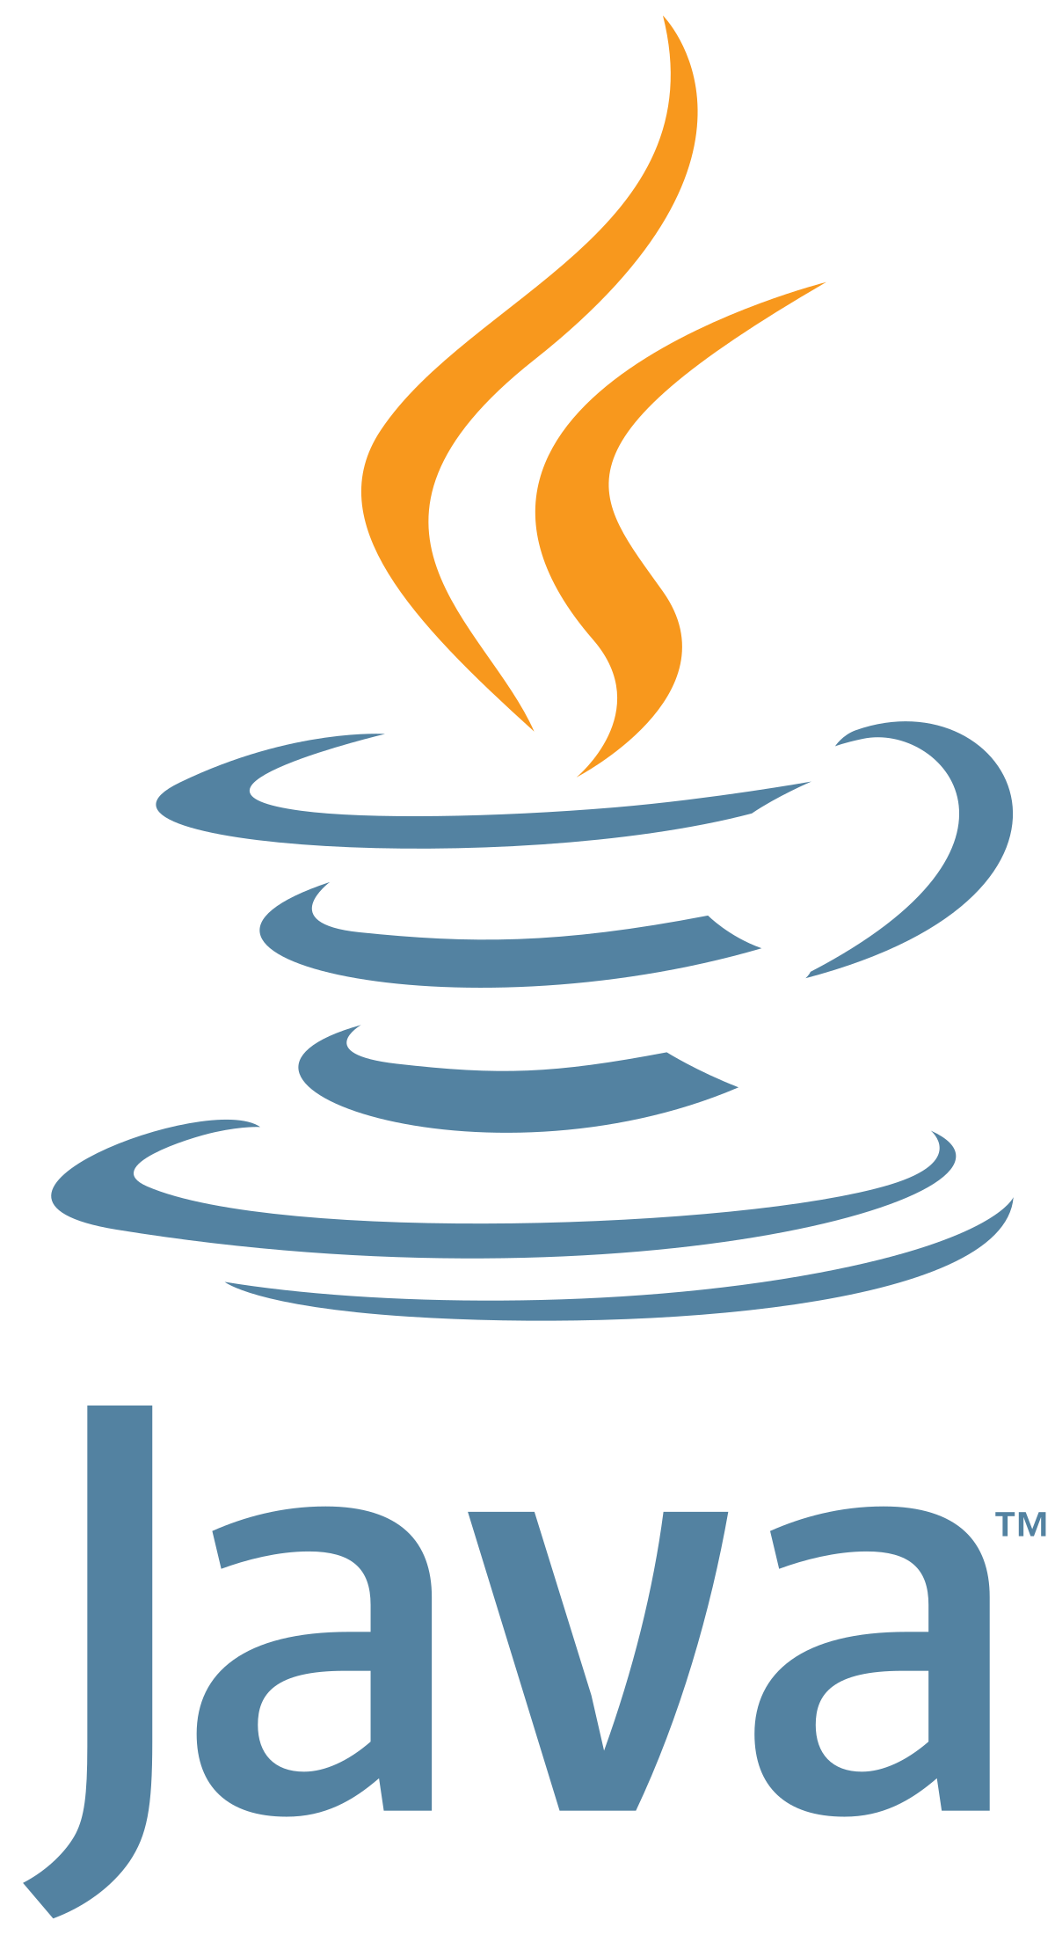
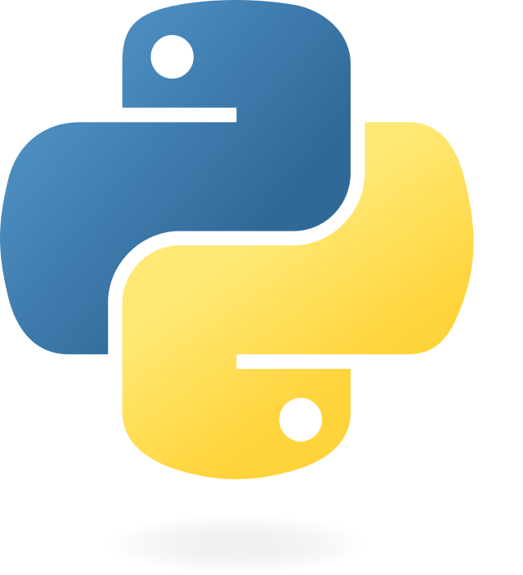

Possible Extension 3 – Hard
Requirement: Run streaming aggregations
Hint 1: Create Amazon Kinesis Data Analytics Application
AWS::KinesisAnalyticsV2::Application
Hint 2: Create a role for the Data Analytics Application
AWS::IAM::Role
Hint 3: Write aggregation logic in Flink using Python, Java, or Scala
Amazon Managed Service for Apache Flink

Slide 18

Useful Links
Description | Link
Official AWS Documentation | https://docs.aws.amazon.com/AWSCloudFormation/latest/UserGuide/Welcome.html
Templates | https://docs.aws.amazon.com/AWSCloudFormation/latest/UserGuide/template-guide.html
Stacks | https://docs.aws.amazon.com/AWSCloudFormation/latest/UserGuide/stacks.html
StackSets | https://docs.aws.amazon.com/AWSCloudFormation/latest/UserGuide/what-is-cfnstacksets.html
Intrinsic Function Reference | https://docs.aws.amazon.com/AWSCloudFormation/latest/UserGuide/intrinsic-function-reference.html
SAM | https://docs.aws.amazon.com/serverless-application-model/latest/developerguide/what-is-sam.html
Troubleshooting | https://docs.aws.amazon.com/AWSCloudFormation/latest/UserGuide/troubleshooting.html

Slide 19


Closer Slide
Thank you
https://www.linkedin.com/in/jagrutsharma/

